Slide 1
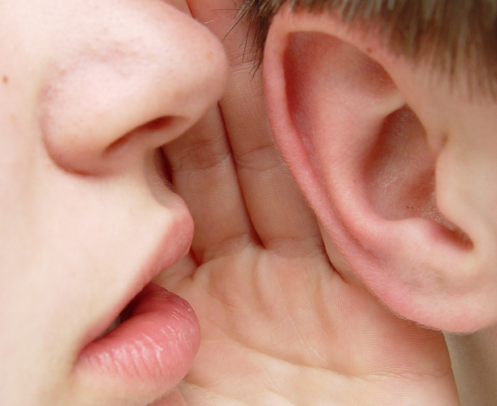
I suppose it’s obvious by now why I’m so afraid, and what is about to happen to me. I’m sure you’ve been through at least one morning like this yourself, either as a potential participant or as a nervous bystander.
What is the effect of inviting the reader into your confidence in this way?
Extension Task - Can you think of any other ways to engage the audiences’ interest in your character?

Slide 2
Everything becomes still. My heart seemed to stop in my chest. We watched the stage nervously. You know the feeling, as though your whole life hangs on that one moment.
Why is it important to consider the lengths of the sentences you use?
Extension Task – How else could you build tension in a piece of description?

Slide 3

Continue your paragraph, building up tension to the moment where the first name is drawn from The Reaping.
Include?

Slide 4
“Don’t watch the games unless you have to...” I pleaded.
“I’ll be fine.”
“I’ll b-” My words caught in my throat as I imploded under the pressure.
What sort of person would you expect the character to be speaking these lines to?
Extension Task – Write a reply to each of these which shows us the other character.

Slide 5
“Don’t watch the games unless you have to...” I pleaded. Who would the character not want to watch the games? Why?
“I’ll be fine.” Who would the character want to appear strong to?
“I’ll b-” My words caught in my throat as I imploded under the pressure. Who would the character be most emotional at leaving?
What sort of person would you expect the character to be speaking these lines to?
Extension Task – Write a reply to each of these which shows us the other character.

Slide 6
Write a goodbye conversation between your character and a family member/close friend.
Use dialogue to show us what the relationship is like.
Remember:
- “Hello.”
- Start a new line each time someone new is speaking

Slide 7
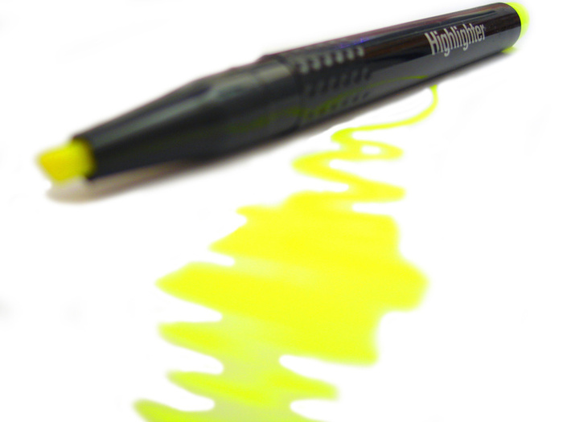
Highlight one example of where they have:
Included character background/history
Shown us something rather than telling us
Used dialogue to show character
Used speech punctuation correctly
Used asides to engage the reader
Have they met today’s L.O.?
What do they still need to improve on?

